Slide 1
Coding for All
Attiano & Matt

Slide 2
Computer Basics
USB
Drag and Drop
Opening applications
Saving files, going to folders

Slide 3
What is Code?
Code is a set of instructions that make your computer programs, apps, and games work.

Slide 4
Harold the Robot
Examples of correct instructions – Robot, pick up first block on your left, etc.
Examples of incorrect instructions – Robot, form a pile of blocks, etc.
Lesson - lines of code must be simple and precise. Code that is not clear, not complete, or more than one task at a time will result in no action, error message, or an action you didn’t want.

Slide 5
Marching Orders Exercise
Drawing Exercise
One person describes lines and shapes on page to another person, who attempts to draw what’s described.
Lesson – Again, lines of code must be simple and precise. Code that is not clear, not complete, or more than one task at a time will result in no action, error message, or an action you didn’t want.

Slide 6

Coding in Scratch – Create Hide and Seek Game
Class has Scratch loaded, open, and maximized. Helpers are ready to assist.
Make sure picture at lower right is highlighted.
Make sure Scripts tab is selected.

Slide 7

Click on button
Control
Drag to top of Scripts area.
Congratulations! This is your first line of code!

Slide 8
Click on button
Variables
Click on
Type ”score” in field, click OK
Drag and drop under
so they snap together.

Slide 9
Click on button
Motion
Drag and drop under
This places your sprite to the center when green flag at upper right of stage is clicked.
Try dragging your sprite off center, then click on the green flag. It should return to center.
Congratulations! This is your first test of code!

Slide 10
Click on button
Looks
Drag (near bottom) and drop under
Drag and drop under
If you want, highlight “Hello” and type “Click on me to score points”
Click on green flag to see result.

Slide 11

Click on button
Control
Drag and drop under
This code is known as a loop, where instructions repeat – upon reaching the end it goes back to the beginning.

Slide 12
Click on button
Looks
Drag and drop inside
loop.
Click on green flag at upper right of stage. Sprite should disappear.
Click on red sign next to green flag to stop.

Slide 13

Click on button
Control
Drag and drop under

Slide 14

Click on button
Motion
Drag and drop under

Slide 15

Click on button
Operators
Drag and drop inside “x: 0”
Change 1 to -200
Change 10 to 200

Slide 16
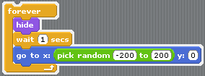
Operators
Drag and drop inside “y: 0”
Change 1 to -140
Change 10 to 140
This code lets your sprite hide anywhere in the stage.

Slide 17
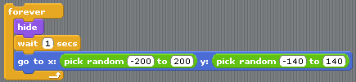
Click on button
Looks
Drag and drop under

Slide 18
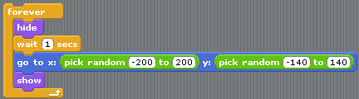
Click on button
Control
Drag and drop under
Change 1 to 2

Slide 19

Control
Drag and drop anywhere under your block of code. This will not snap into place like the other lines.

Slide 20
Click on button
Variables
Drag and drop under

Slide 21
Click on button
Sound
Drag and drop under

Slide 22
Play Your Game
Start by clicking on the green flag at upper right of stage
Stop by clicking on the red sign next to green flag

Slide 23
Change the Code – Change the Game
Insert a background
Change the sound
Change the time to make it harder or easier to catch the sprite
Change the sprite
Add a glide motion to the sound
Add a costume
Change color

Slide 24
Other Activities
Go to Scratch website found under Share menu (https://scratch.mit.edu/) for additional games, animation, and projects
Attiano’s blog for links to other coding sites
Thanks to all for participating

